Slide 1

My Linear Relationships Interactive Notebook
Name:
Class:
Teacher:
Semester 2
Term 4
1

Slide 2
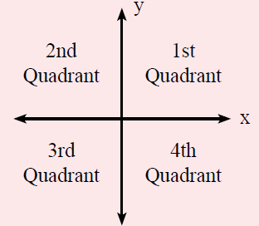

24
7
30
Topic: Linear Relationships
Date
EQ – How do I plot points on a Cartesian Plane?
What is the Cartesian Plane?
The Cartesian Plane has 4 quadrants, split up by the
___-axis (horizontal)
___-axis (vertical).
The center, where the axis meet, is called the origin.
$$Coordinates are \left(x ,y\right)$$

Slide 3
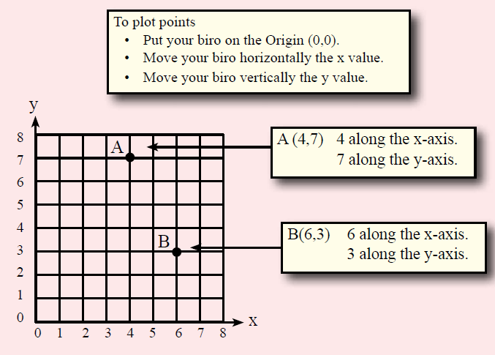
24
7
30
Topic: Linear Relationships
Date
EQ – How do I plot points on a Cartesian Plane?
How do you plot points on a Cartesian Plane?

Slide 4
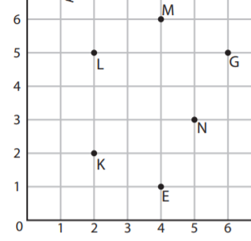
Your turn

Slide 5
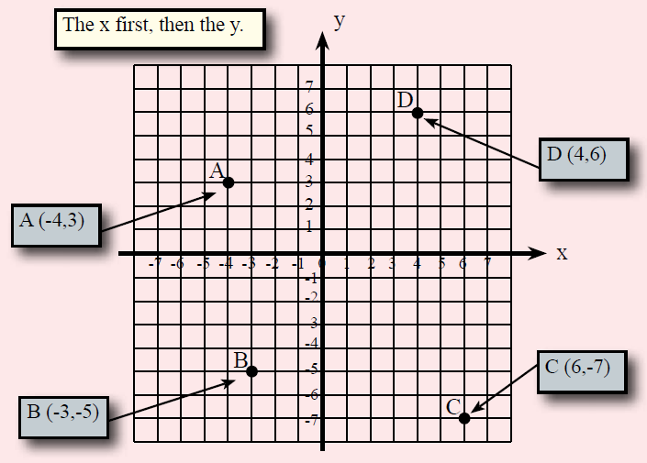
24
7
30
Topic: Linear Relationships
Date
EQ – How do I plot points on a Cartesian Plane?
How do you plot points on a Cartesian Plane?

Slide 6
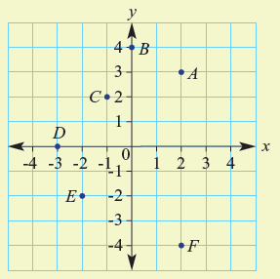

Let’s try one together
Write down the coordinates for A-F

Slide 7

Do you understand?
Notes:
Check for Understanding

Slide 8

Your Turn
WORKSHEETS
Left Hand Side

